Slide 1
Brng_stoc_snn.py
김문기, 노윤지

Slide 2
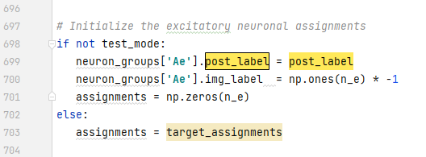


Slide 3
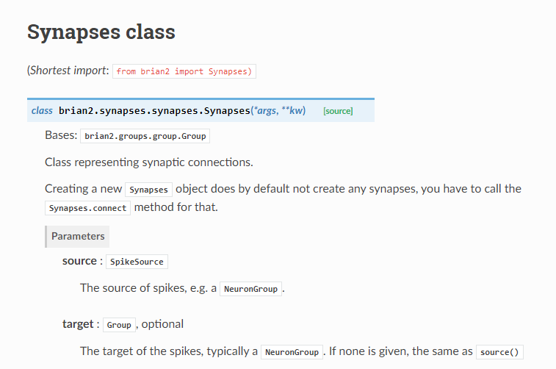

Slide 4



Slide 5


Slide 6
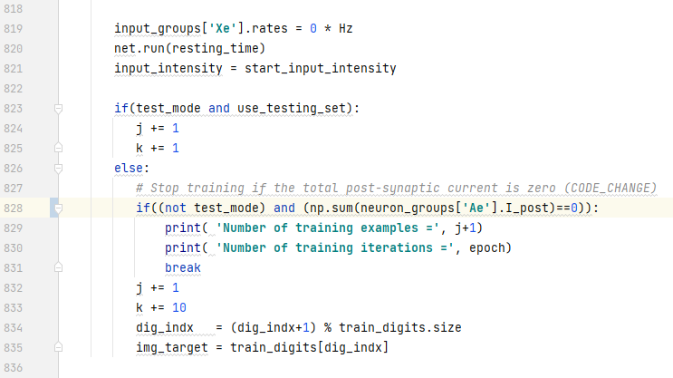


Slide 7
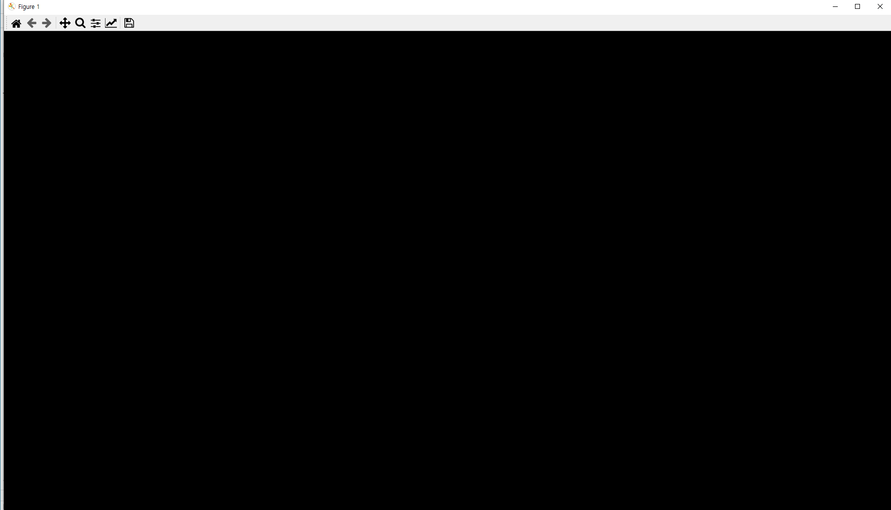

Slide 8



Slide 9
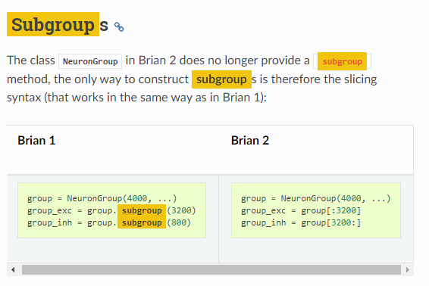

Slide 10




Slide 11



Slide 12




Slide 13


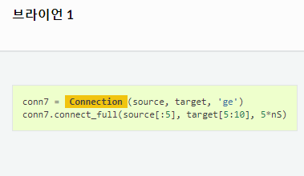
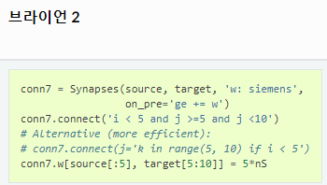

Slide 14
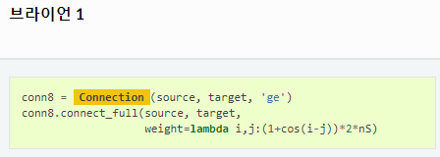
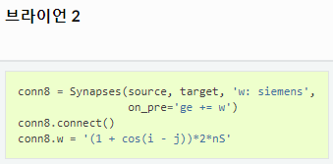


Slide 15


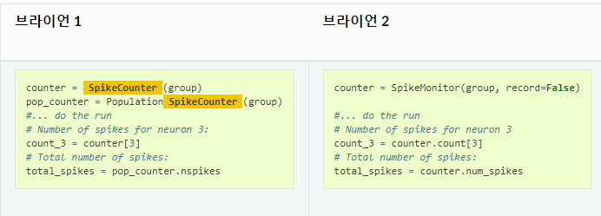

Slide 16


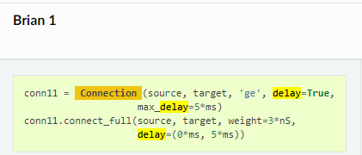
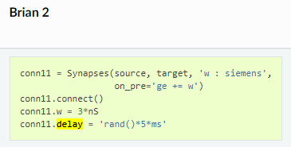

Slide 17


Slide 18



Slide 25

10x340 784x10 784x340 1x10
u(j, t+1) = weights_e(:, j)'*EPSP(:, t) - I(j)
1x1 784x1 -> 1x784 784x1 1x1
u(j, t+1) = weights_e(:, j)'*EPSP(:, t) ) - I(j)

Slide 26
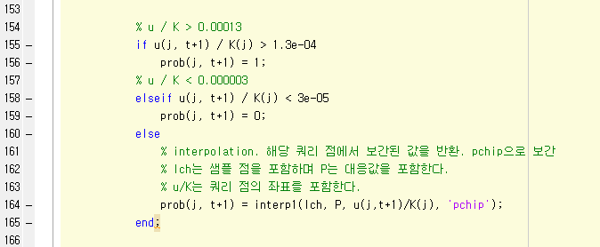

Slide 27
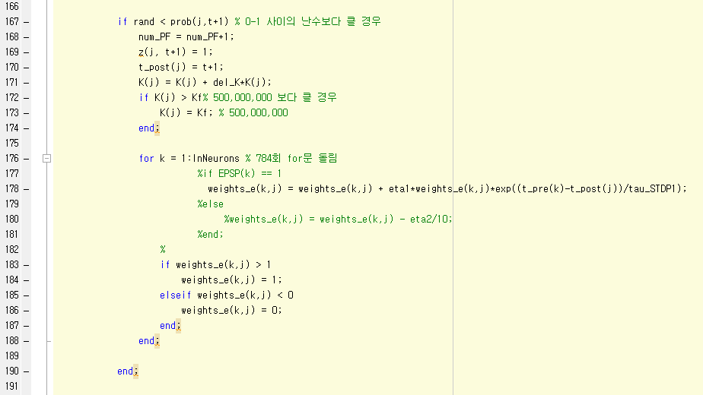


Slide 28


Slide 29
